Slide 1


Introduction to DiffusionSat - GIS Lab 2024 Short-term Course
Presentor: Sakura (Chen Zhenyuan) M.Eng.
Department: School of Earth Science, Zhejiang University
Contact me: bili_sakura@zju.edu.cn
Date: July 9, 2024
© Sakura, 2024. All rights reserved.

Slide 2
Outline
Overview
Model Architecture
SD
SD + ControlNet
Single Image Generation
Textual Prompt + Numerical Metadata
Inverse Problems
Superresolution
Temporal Prediction
Temporal Inpainting
Temporal Sequence Generation
Implementation in Python Project
© Sakura, 2024. All rights reserved.

Slide 3
Overview
© Sakura, 2024. All rights reserved.

Slide 4
Abstract of DiffusionSat
Diffusion models have achieved state-of-the-art results on many modalities including images, speech, and video. However, existing models are not tailored to support remote sensing data, which is widely used in important applications including environmental monitoring and crop-yield prediction. Satellite images are significantly different from natural images -- they can be multi-spectral, irregularly sampled across time -- and existing diffusion models trained on images from the Web do not support them. Furthermore, remote sensing data is inherently spatio-temporal, requiring conditional generation tasks not supported by traditional methods based on captions or images. In this paper, we present DiffusionSat, to date the largest generative foundation model trained on a collection of publicly available large, high-resolution remote sensing datasets. As text-based captions are sparsely available for satellite images, we incorporate the associated metadata such as geolocation as conditioning information. Our method produces realistic samples and can be used to solve multiple generative tasks including temporal generation, superresolution given multi-spectral inputs and in-painting. Our method outperforms previous state-of-the-art methods for satellite image generation and is the first large-scale generative foundation model for satellite imagery.
扩散模型在图像、语音和视频等多种模态上取得了最先进的成果。然而，现有模型并不支持在重要应用如环境监测和作物产量预测中广泛使用的遥感数据。卫星图像与自然图像显著不同——它们可以是多光谱的、时间上不规则采样的。现有的扩散模型无法处理这些数据。遥感数据本质上是时空数据，需要传统基于字幕或图像的方法不支持的条件生成任务。本文提出了DiffusionSat，这是迄今为止基于公共大规模高分辨率遥感数据集训练的最大生成基础模型。由于卫星图像的文字描述稀少，我们结合了地理位置等相关元数据作为条件信息。我们的方法生成逼真的样本，可用于解决多种生成任务，包括时间生成、多光谱输入的超分辨率和修复。我们的方法在卫星图像生成方面优于现有最先进的方法，是第一个大规模的卫星图像生成基础模型。
© Sakura, 2024. All rights reserved.

Slide 5
Model Architecture
SD
SD + ControlNet
© Sakura, 2024. All rights reserved.

Slide 6
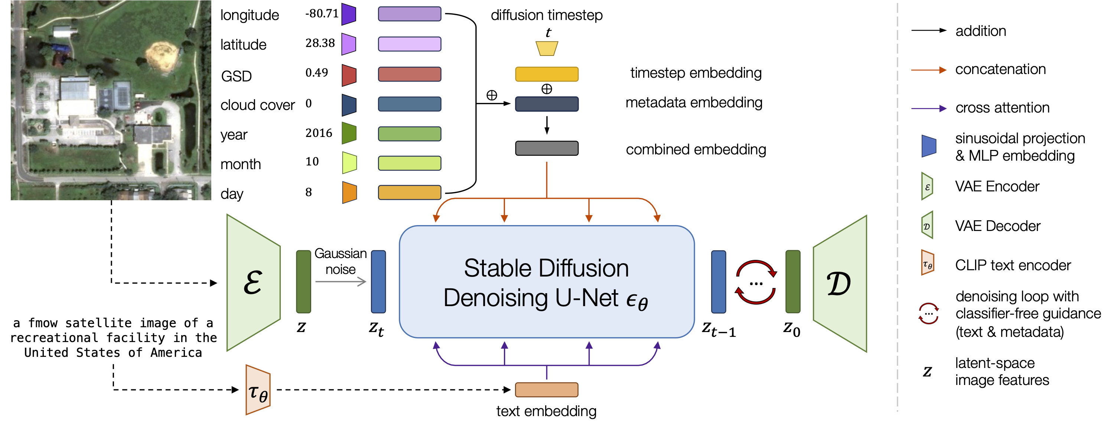
SD: Stable Diffusion for Satellite Image Generation
Core Component of DiffusionSat: Stable Diffusion based Image Generation Model.
© Sakura, 2024. All rights reserved.

Slide 7
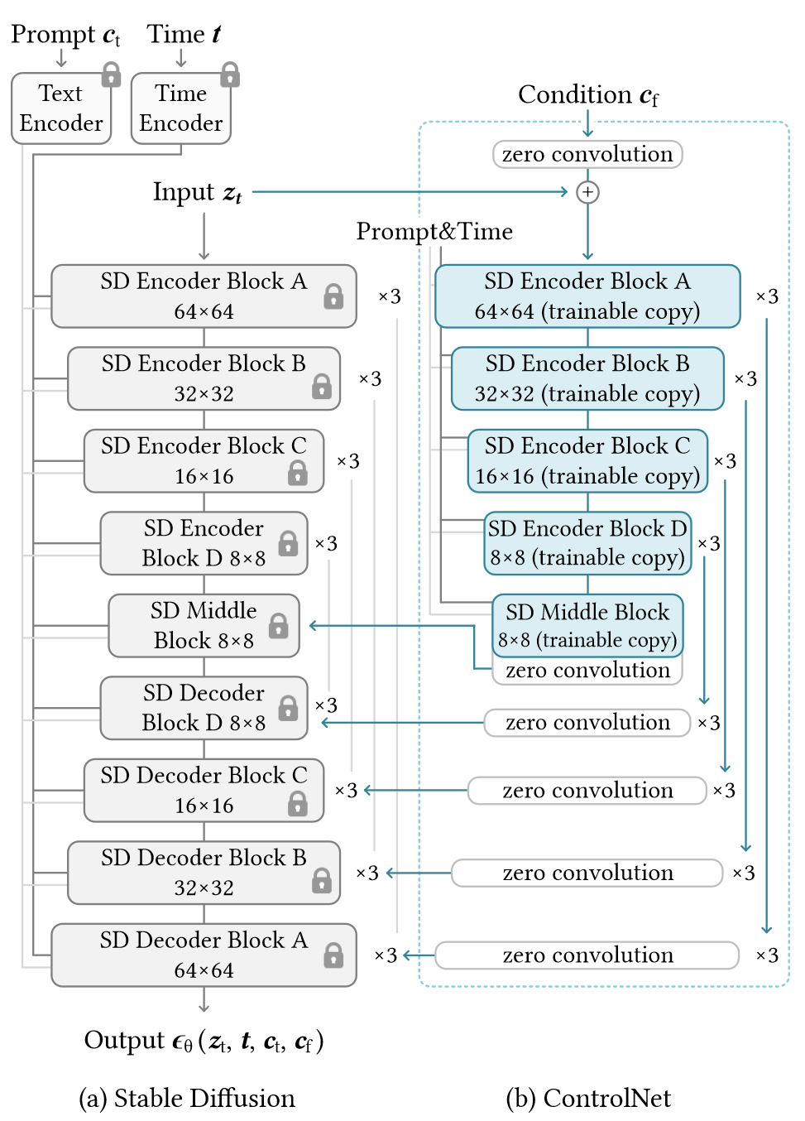
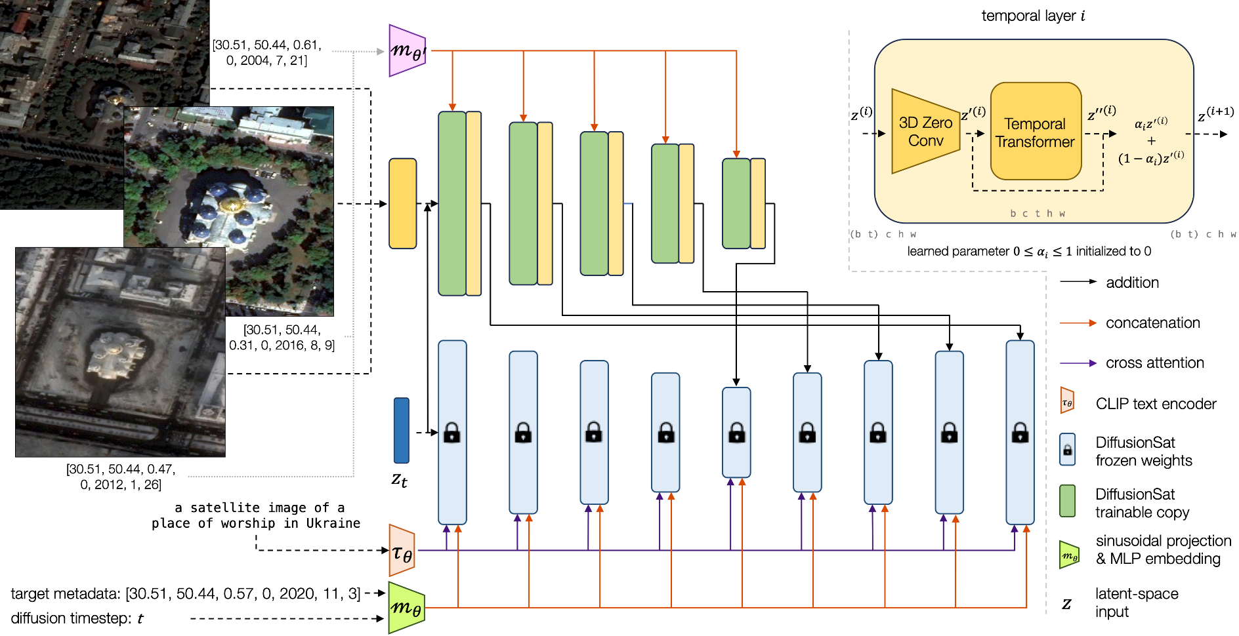
SD + ControlNet: Conditional Image Generation
Architecture of DiffusionSat: Stable Diffusion (fine-tuning on SD 2.1) + ControlNet3D.
© Sakura, 2024. All rights reserved.

Slide 8
Single Image Generation
Textual Prompt + Numerical Metadata
© Sakura, 2024. All rights reserved.

Slide 9
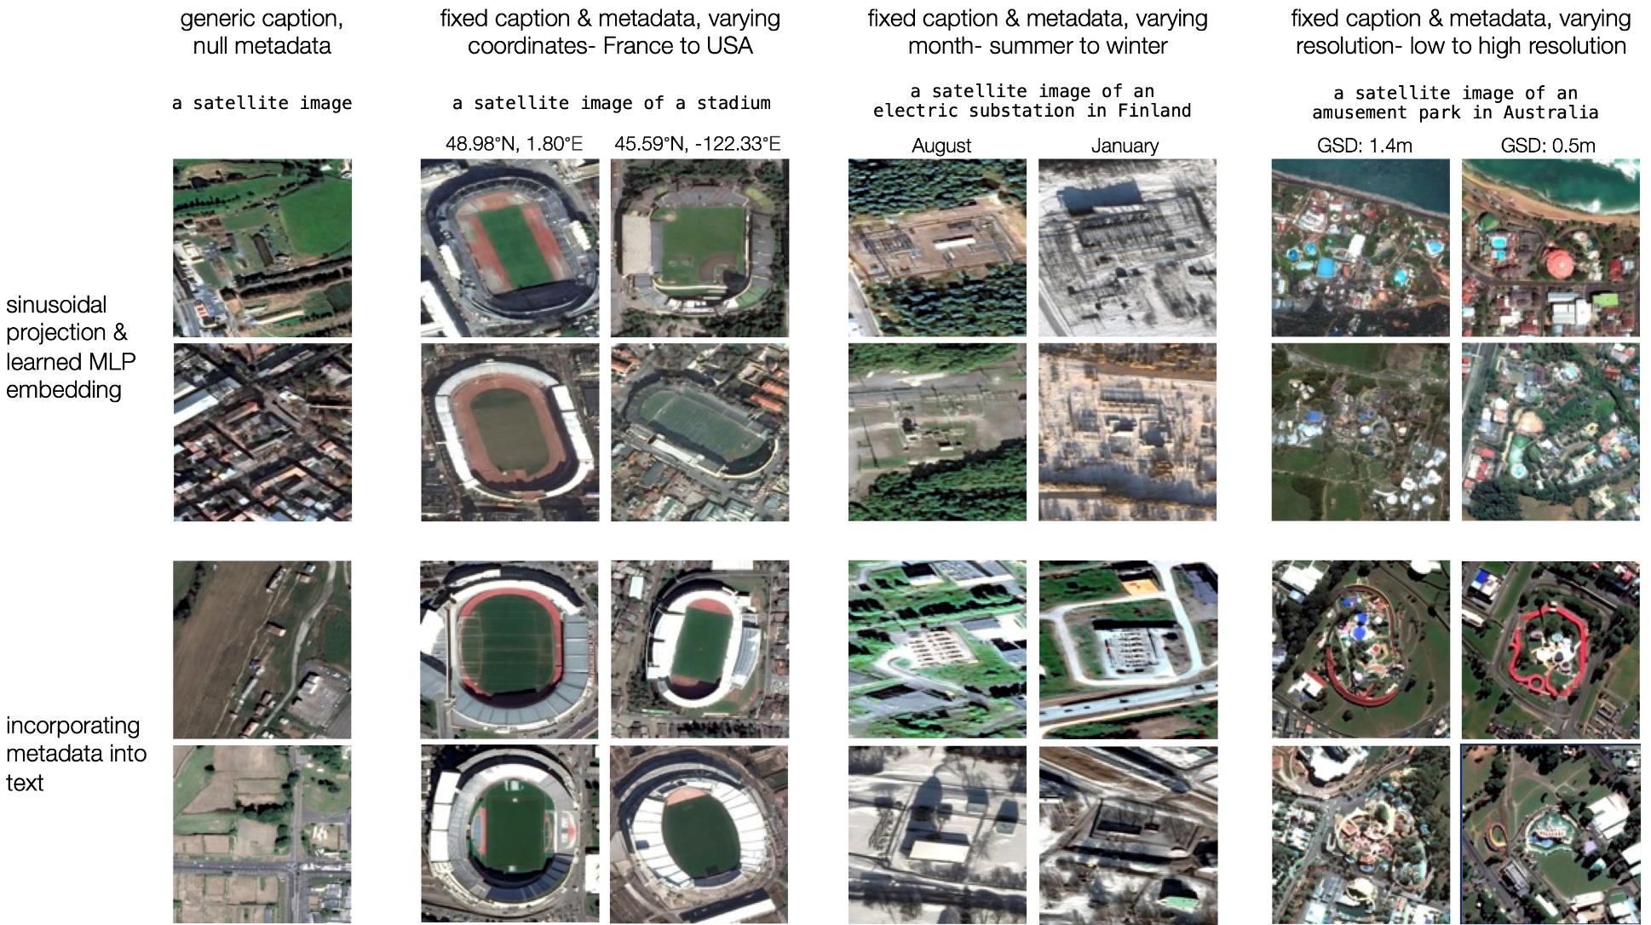
Textual Prompt + Numerical Metadata
Comparison of metadata in textual prompt . Above: using sinusoidal projection and MLP embedding (our method). Below: naïve in prompt as textual information.
© Sakura, 2024. All rights reserved.

Slide 10
Inverse Problems
Superresolution
Temporal Prediction
Temporal Inpainting
Temporal Sequence Generation
© Sakura, 2024. All rights reserved.

Slide 11
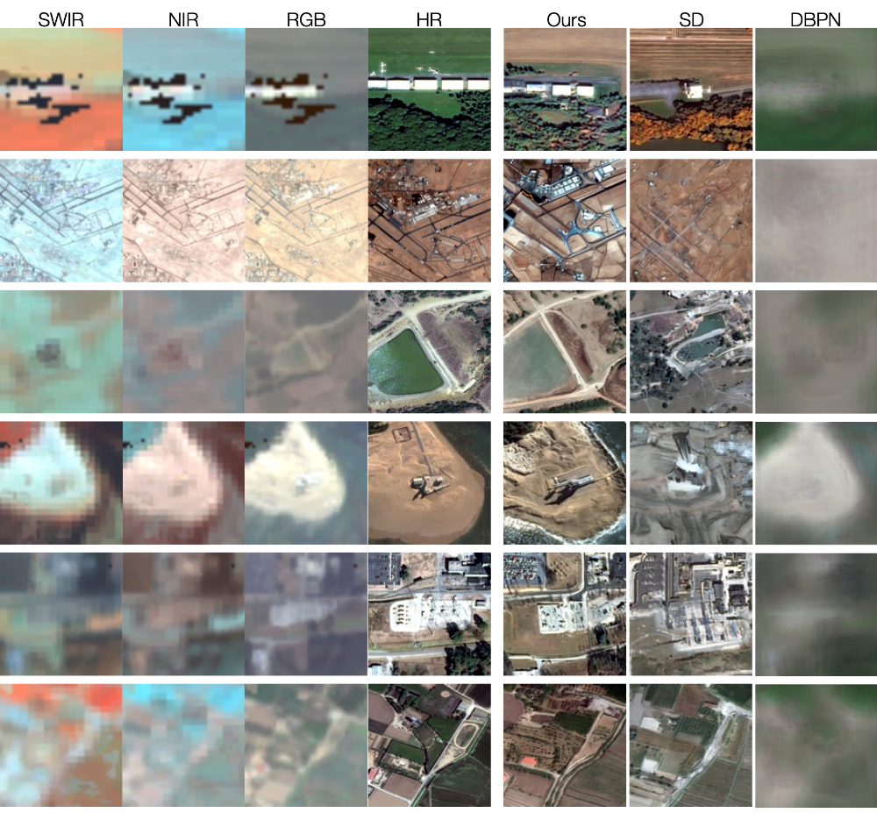
Superresolution
Method | FID↓ | IS↑ | CLIP↑
SD 2.1 | 117.74 | 6.42 | 17.23
SD 2.1 w/o metadata | 37.99 | 7.42 | 16.59
SD 2.1 w metadata | 24.23 | 7.60 | 18.62
Ours | 15.80 | 6.69 | 17.20
Method | SSIM↑ | PSNR↑ | LPIPS↓ | MSE↓
Pix2Pix | 0.1374 | 8.2722 | 0.6895 | 0.1492
DBPN | 0.1518 | 11.8568 | 0.6826 | 0.0680
SD | 0.1671 | 10.2417 | 0.6403 | 0.0962
SD + CN | 0.1626 | 10.0098 | 0.6506 | 0.1009
Ours | 0.1703 | 10.3924 | 0.6221 | 0.0928
Generated samples from fMoW-Sentinel superresolution validation set. The conditioning image is the Sentinel-2 multispectral (MS) image represented here as SWIR, NIR, RGB. The desired output is the high-resolution (HR) fMoW-RGB image. Our method is able to capture fine-grained details better than other baselines, even when the low-resolution MS image lacks detail. SD tends to “hallucinate" details.
© Sakura, 2024. All rights reserved.

Slide 12
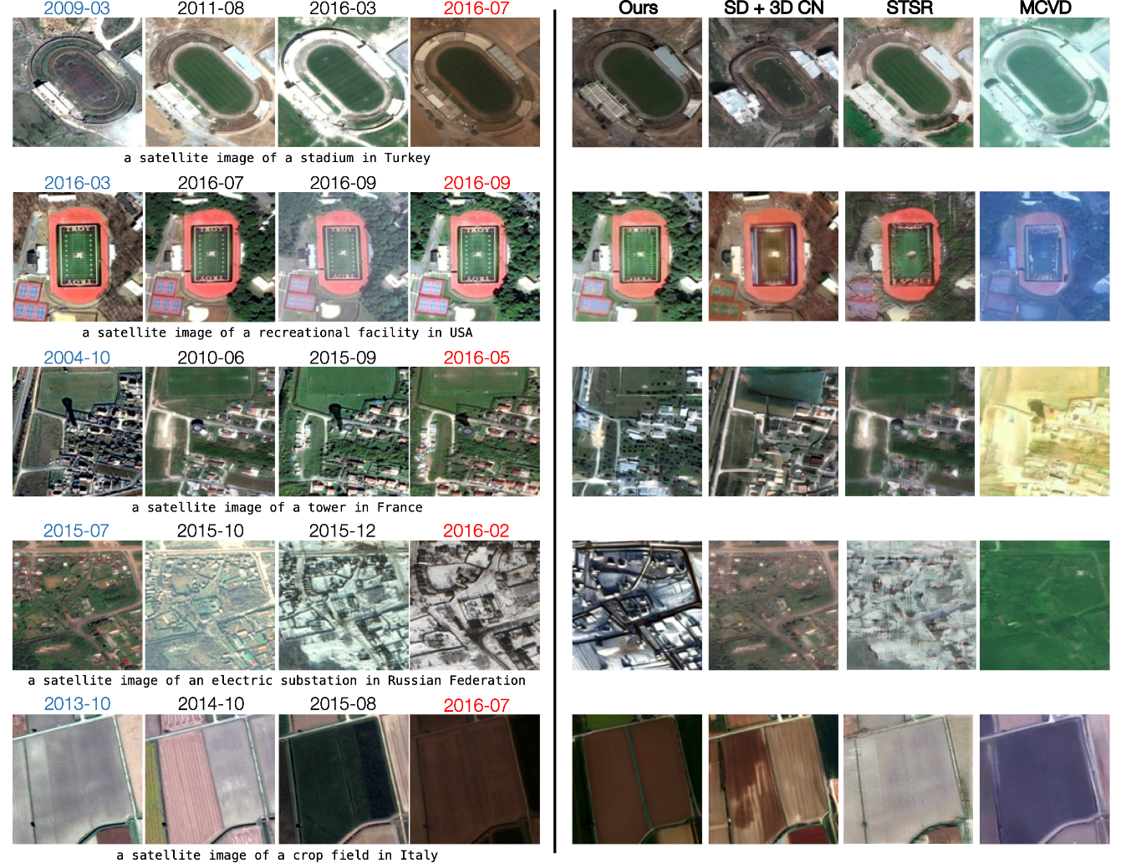
Temporal Prediction
Model | t′ > t
 | SSIM↑ | PSNR↑ | LPIPS↓
STSR (EAD) | 0.3657 | 13.5191 | 0.4898
MCVD | 0.3110 | 9.6330 | 0.6058
SD + 3D CN | 0.2027 | 11.0536 | 0.5523
DiffusionSat + CN | 0.3297 | 13.6938 | 0.5062
DiffusionSat + 3D CN | 0.3983 | 13.7886 | 0.4304
Generated samples from the fMoW-temporal validation set, for temporal prediction. The 4 columns in the center are ground-truth images from the temporal sequence. To the right, we see generated samples for the future-prediction task. The goal is to generate the image marked by the date in red, given the 3 other images (to its left) as conditioning signals.
© Sakura, 2024. All rights reserved.

Slide 13
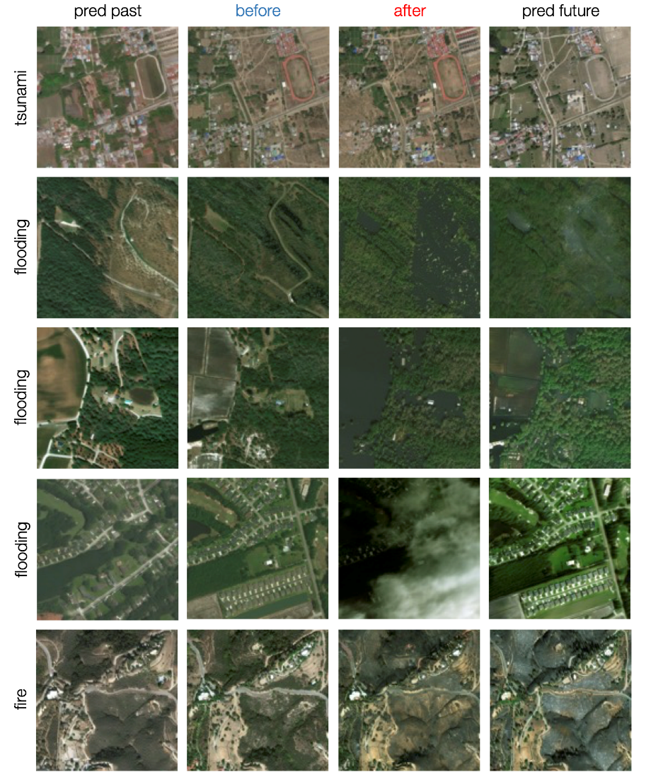
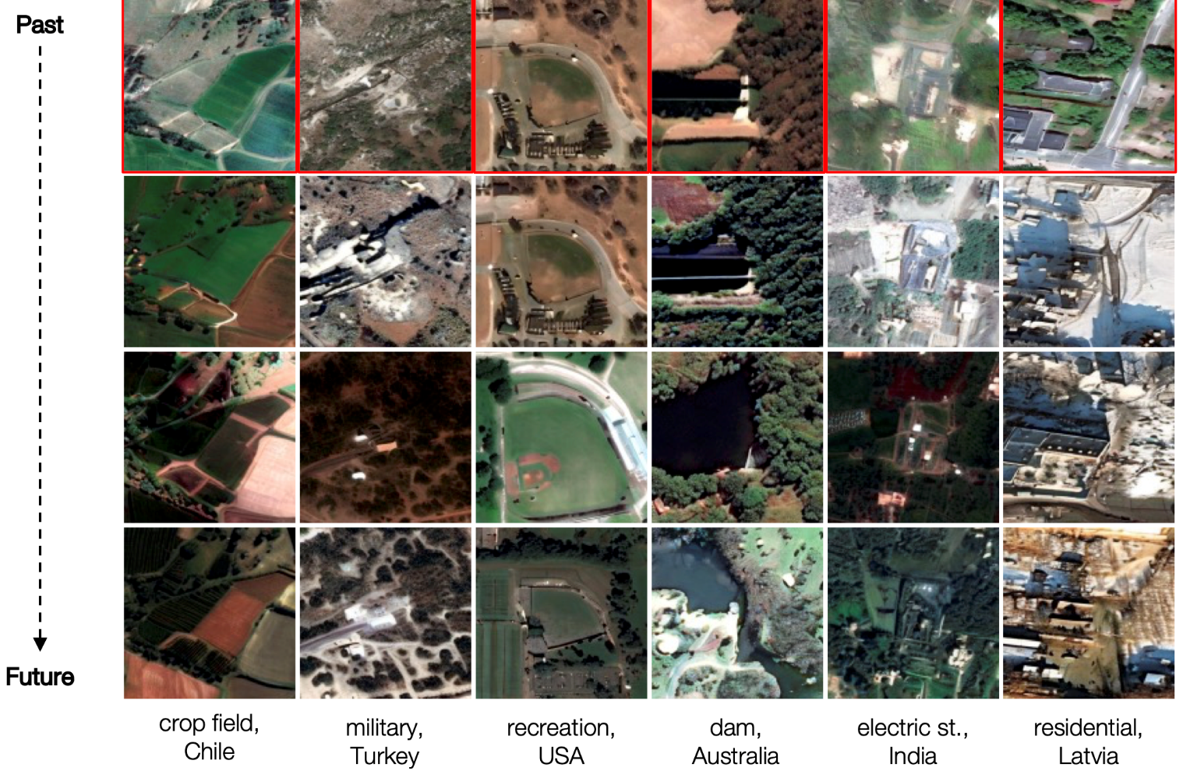
Temporal Inpainting & Temporal Sequence Generation
Temporal Inpainting
Temporal Sequence Generation
© Sakura, 2024. All rights reserved.

Slide 14
Practice on DiffusionSAT Project:
- Let’s have a comprehensive understanding of DiffusionSAT!
© Sakura, 2024. All rights reserved.

Slide 15
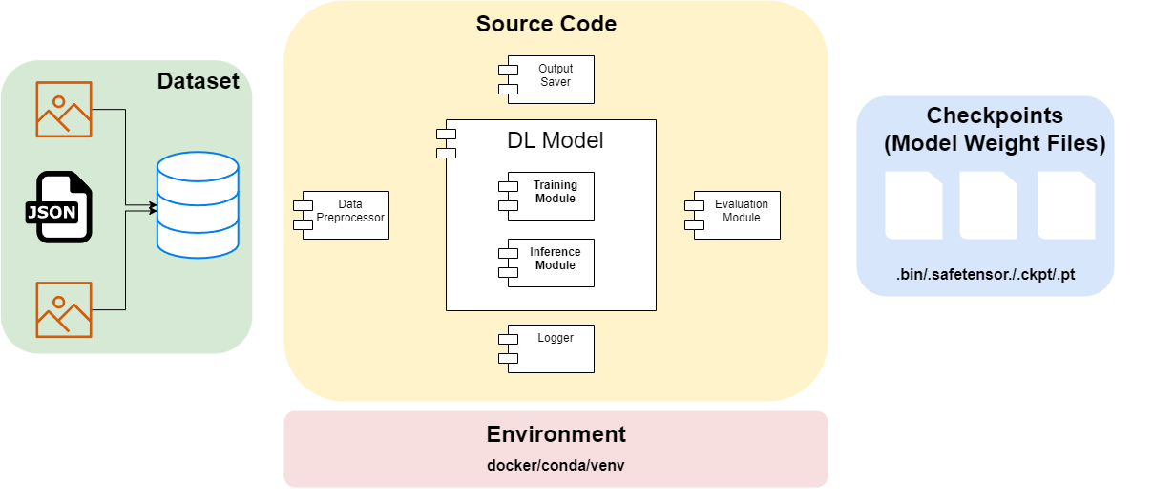
How a Python Project Structred?
Illustration of Common Python Project for Deep Learning.
© Sakura, 2024. All rights reserved.

Slide 16
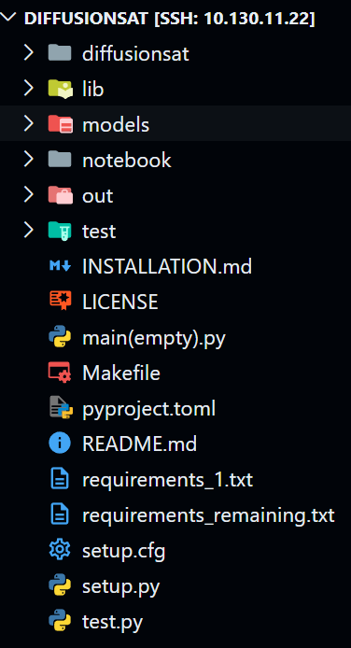
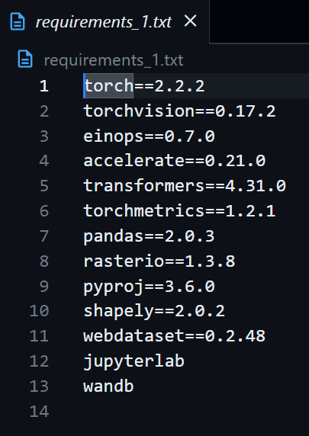
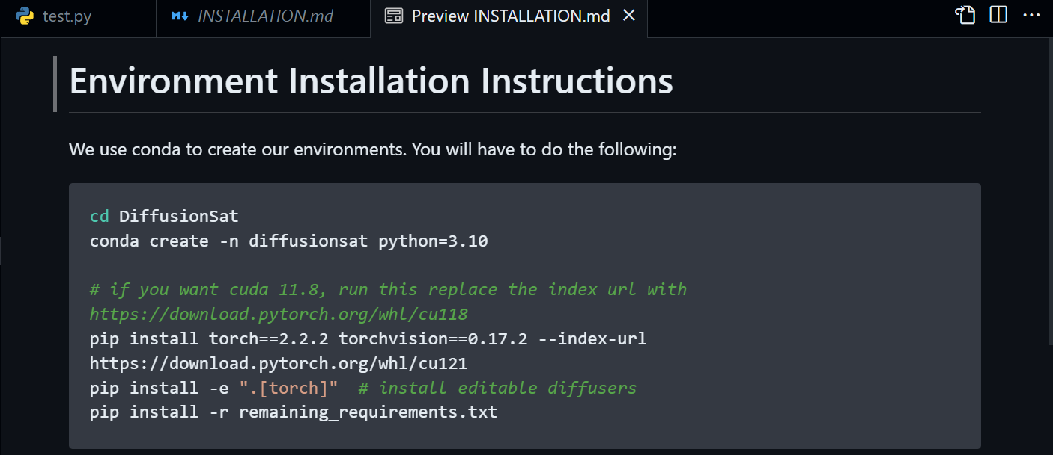
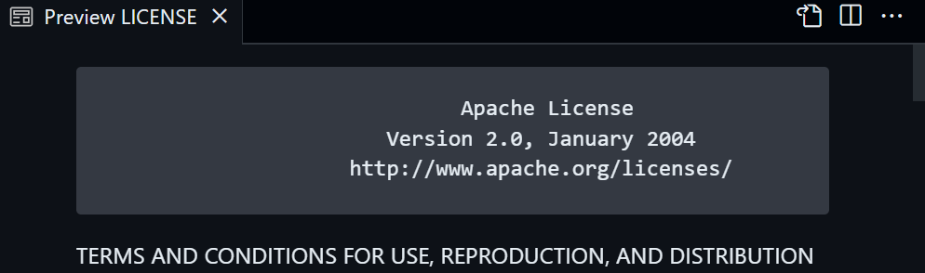
Decomposition of Project: take DiffusionSat as an example
Docs and Envs.
© Sakura, 2024. All rights reserved.

Slide 17
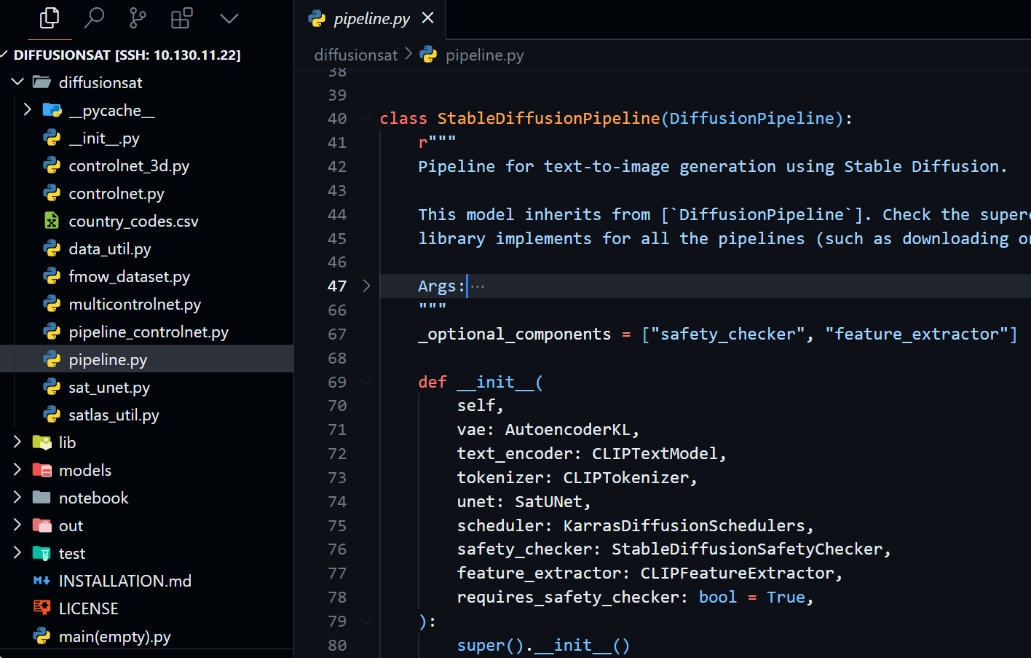
Decomposition of Project: take DiffusionSat as an example
Core of Source Code: Model Architecture Declaration and Component Classes.
© Sakura, 2024. All rights reserved.

Slide 18
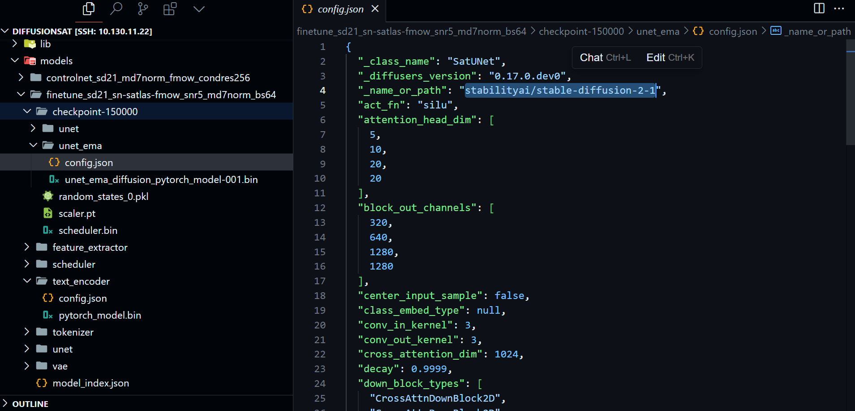
Decomposition of Project: take DiffusionSat as an example
Checkpoints.
© Sakura, 2024. All rights reserved.

Slide 19
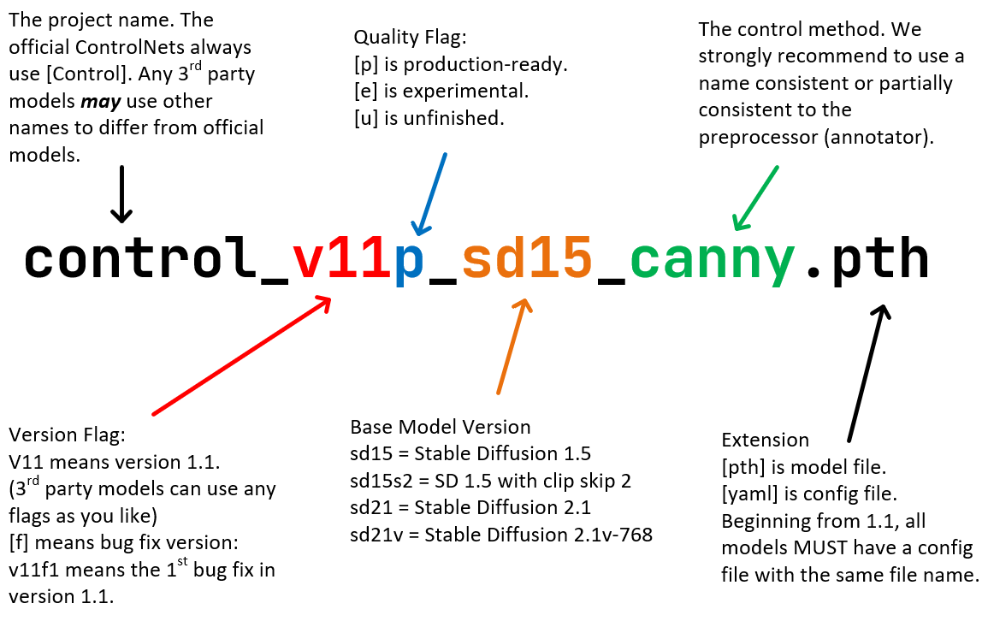
Others
Single Image Generation Model Checkpoint
finetune_sd21_sn-satlas-fmow_snr5_md7norm_bs64
finetune_sd21_256_sn-satlas-fmow_snr5_md7norm_bs64
Conditional Version Checkpoint
Superresolution(probably)
controlnet3d-mixattn_sd21_md7norm_texas
controlnet_sd21_md7norm_fmow_condres256
finetune: further train sd with satellite data
controlnet: conditioning training with 2d controlnet
controlnet3d: conditioning training with 3d controlnet
sd21: stable diffusion v2.1
sn: SpaceNet dataset
satlas: Satlas dataset
fmow: fMoW dataset
texas: Texas Housing Dataset
snr5: Signal-to-Noise Ratio (SNR) = 5
md7norm: md7 normalization
bs64: batch size = 64
condres256:conditional resolution 256x256 pixels.
Standard ControlNet Naming Rules (SCNNRs).
https://github.com/lllyasviel/ControlNet-v1-1-nightly?tab=readme-ov-file#model-specification
© Sakura, 2024. All rights reserved.

Slide 20
References and Related Works
[1] S. Khanna et al., ‘DiffusionSat: A Generative Foundation Model for Satellite Imagery’, in International Conference on Learning Representations, Dec. 2023. Accessed: Jul. 07, 2024. [Online]. Available: https://openreview.net/forum?id=I5webNFDgQ
[2] R. Rombach, A. Blattmann, D. Lorenz, P. Esser, and B. Ommer, “High-Resolution Image Synthesis With Latent Diffusion Models,” presented at the Proceedings of the IEEE/CVF Conference on Computer Vision and Pattern Recognition, 2022, pp. 10684–10695. Accessed: Jun. 29, 2024. [Online]. Available: https://openaccess.thecvf.com/content/CVPR2022/html/Rombach_High-Resolution_Image_Synthesis_With_Latent_Diffusion_Models_CVPR_2022_paper.html
[3] L. Zhang, A. Rao, and M. Agrawala, “Adding Conditional Control to Text-to-Image Diffusion Models,” in 2023 IEEE/CVF International Conference on Computer Vision (ICCV), Oct. 2023, pp. 3813–3824. doi: 10.1109/ICCV51070.2023.00355.
[4] D. Podell et al., “SDXL: Improving Latent Diffusion Models for High-Resolution Image Synthesis,” presented at the The Twelfth International Conference on Learning Representations, Oct. 2023. Accessed: Jul. 07, 2024. [Online]. Available: https://openreview.net/forum?id=di52zR8xgf
[5] P. Esser et al., “Scaling Rectified Flow Transformers for High-Resolution Image Synthesis,” presented at the Forty-first International Conference on Machine Learning, Jun. 2024. Accessed: Jul. 07, 2024. [Online]. Available: https://openreview.net/forum?id=FPnUhsQJ5B
© Sakura, 2024. All rights reserved.

